Slide 1
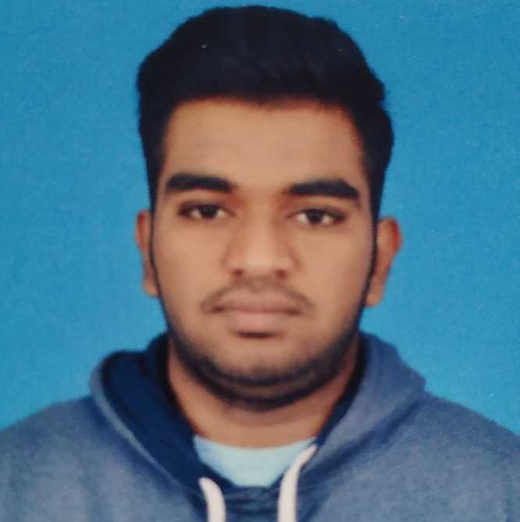



NAGARJUN P
Analyst/Software Engineer
Bachelor of Computer Science and Engineering:2017-2021
Skills
Bangalore
Backend
Spring Boot/Spring Security
MongoDB
REST-API
Database
NoSQL database – MongoDB
Web Technologies
HTML5
CSS3
Bootstrap
JavaScript/TypeScript
UI Framework
React
Add-ons
GitHub
Postman
Additional Details
Excellent Communication Skills
Team Player
nagarjun.a.p@capgemini.com
+91 9113581829
A4
Proficient in JAVA and OOPs concepts.
Hands on experience in creating Web Application with JAVA Spring Boot, REST API and React.
Hands on experience in developing web pages using HTML5, CSS3, JavaScript and TypeScript.
Practical understanding of Java Spring Boot, REST API.
Has working knowledge on React and Java Microservice Development using Spring framework.
Implemented REST API and React in case study and up skilling this knowledge continuously.
Railway Reservation System
Completed end to end case study of Railway Reservation System along with JWT authentication using Spring boot Microservices with Eureka Server. React used for user interface.
Java and React for web developers in Degreed Platform
Completed this course with optimal Knowledge of Spring Boot, RESTful services , React.

